Slide 1
Idle Free Schools
Implementing an Idling Reduction campaign in Your school

Slide 2
Air Pollution Primer
The air we breathe is polluted by activities we do every day.
These activities add gases and particulates to the air, which can accumulate in high enough concentrations to harm human health and the environment.
Notes:
First, we’ll start with some background information on Air Pollution to help explain why an idle reduction campaign is important and worth undertaking.
Many of our everyday activities contribute to air pollution, such as
driving cars and trucks;
burning coal, oil and other fuels;
and manufacturing products.
The pollution from all of these activities can build up and accumulate in high enough concentrations to harm human health and the environment.
This picture shows smog, typical in many U.S. cities.

Slide 3
Hazardous Air Pollutants
EPA has listed 188 Hazardous Air Pollutants, also called Air Toxics.
Some Air Toxics are known to cause cancer, respiratory effects, reproductive effects, birth defects or other serious health effects.
EPA has identified 33 Priority List Air Toxics that present the greatest threat to public health and the environment.
Notes:
There is an extremely large universe of air pollutants – both identified and not identified.
One universe of air pollutants is called Hazardous Air Pollutants, also known as Air Toxics.
There are 188 EPA identified Air Toxics.
Some Air Toxics are known to cause serious health effects, like cancer.
A subset of Air Toxics are Priority Air Toxics that present the greatest threat to public health and the environment.

Slide 4
Mobile Source Air Toxics
There are also
air toxics that are emitted from mobile sources (e.g., cars).
These are called Mobile Source Air Toxics (MSATs)
Notes:
Another subset of air toxics are Mobile Source Air Toxics, or MSATs, which are Air Toxics emitted from mobile sources.
Mobile sources include
cars, trucks and buses,
and non-road vehicles like boats, trains and construction and agricultural equipment.

Slide 5
Mobile Source Air Toxics
More than 1,000 compounds have been identified in exhaust and evaporative emissions from mobile sources.
MSATs have the potential for serious adverse health effects and are responsible for about 50% of the cancer risk nationwide.
Nationwide, mobile sources represent the largest contributor to air toxics.
Notes:
More than 1,000 different compounds have been identified in exhaust and evaporative emissions from mobile sources.
MSATs have the potential for serious health effects and many MSATs are also Priority Air Toxics, which again, are the air toxics that present the greatest threat to human health and the environment.
MSATs are responsible for about 50% of the nationwide cancer risk.
In the US, mobile sources are the number one contributor to Air Toxics.

Slide 6
Examples of MSATs
*Also on EPA Priority HAP List
Acetaldehyde* | Diesel Exhaust | MTBE
Acrolein* | Ethylbenzene | Naphthalene
Arsenic cpds* | Formaldehyde* | Nickel cpds*
Benzene* | N-Hexane | POM (Sum of 7 PAH)*
1,3-Butadiene* | Lead cpds* | Styrene
Chromium cpds* | Manganese cpds* | Toluene
Dioxin/Furans* | Mercury cpds* | Xylene
Notes:
Here are some mobile source air toxics.
Among them are Dioxin, Formaldehyde, Lead, Mercury, and Benzene, all of which are also priority air toxics.

Slide 7
Mobile Sources and Global Climate Change
MSATs produce greenhouse gases, such as carbon dioxide (CO2), which trap heat in the Earth’s atmosphere, contributing to global climate change.
Notes:
In addition to air toxics, mobile sources also produce greenhouse gases, like carbon dioxide.
Greenhouse gases trap heat in the atmosphere and contribute to global climate change.
During the past century, humans have substantially added to the amount of greenhouse gases in the atmosphere by burning fossil fuels.
The added gases are enhancing the natural greenhouse effect, and likely contributing to an increase in global average temperature and related climate changes.

Slide 8
Children and Air Pollution
Children are especially susceptible to
Air Pollution
Notes:
So now that we’ve described why it is so important to reduce Air Toxics, in particular Mobile Source Air Toxics, lets talk about why we are focusing on air pollution at schools.

Slide 9
Children and Air Pollution
Humans inhale/exhale 9,000 to 15,000 liters air/day
Children’s developing lungs have a smaller surface area and a higher inhalation rate, which means greater exposure and potentially permanent damage to lung function.
Early childhood: 20-40 breaths/min.
Late childhood: 15-25 breaths/min.
Adults: 12-18 breaths/min.
Notes:
Children’s lungs are still developing and they have a higher inhalation rate, which means greater exposure and potentially permanent lung damage.
As you can see, children breath at a much faster rate.
While an adult breathes at a rate of 12-18 breaths per minute, a young child breathes at a rate of 20-40 breaths per minute.

Slide 10
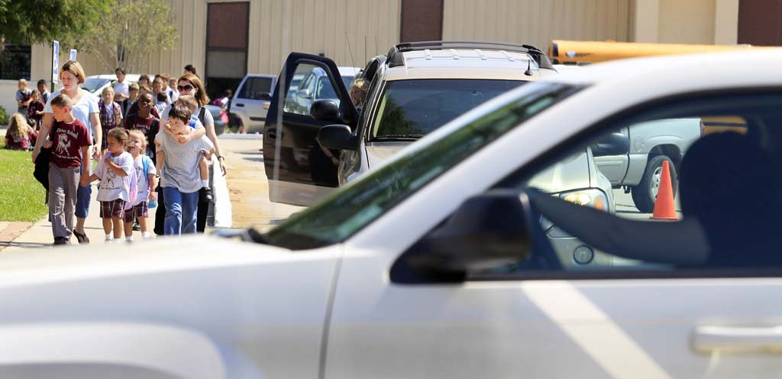
Vehicle Idling at Schools: The Problem
Monitoring at schools have shown elevated levels of air toxics during the afternoon hour coinciding with parents picking up their children.
Notes:
In 2004, the Denver Department of Environmental Health obtained grant funding from EPA to conduct a Community Based Air Toxics Study.
The project measured the various levels of pollution in Denver by collecting ambient air samples. Two of the four monitoring sites were on rooftops of Denver Public Schools.
Monitoring data from these sites showed elevated levels of benzene, formaldehyde and other air toxics.
One monitor was on the roof of a school located very close to one of the major highways running through Denver. The data collected there showed that there were noticeable spikes in pollution during the 3-4pm hour, coinciding with when students are released from school.
The concentrations of benzene and soot were higher during the 3-4pm hour than they were for the 5pm rush hour.

Slide 11
Vehicle Idling at Schools: The Problem
Idling engines produce thousands of tons of toxic pollution per year.
Limiting idling can dramatically reduce these pollutants and your children’s exposure to them.
Notes:
As a response, the City and County of Denver created the Clean Air at Schools Engines Off (CASEO) program, which is an idling reduction program for schools.
They have partnered with the Colorado Department of Transportation and the American Lung Association to bring the program to several schools in the state.
With CASEO, staff from these organizations actually go into a school and run the program. They do all of the work AND provide funding for the no idling signs and the incentives.
However, CASEO is limited by staff resources (they can only get to a few schools a year) and to schools in CO.

Slide 12
The Idle Free Schools Toolkit
The Idle Free Schools Toolkit was designed to help schools implement idling reduction campaigns and reduce unnecessary vehicle idling.
The Toolkit includes everything needed to run an effective idling reduction campaign at a school.
While all of the activities described in the Toolkit are strongly recommended to create a more effective and lasting program, schools need to decide how to best implement an idling reduction campaign at their own school.
Notes:
So EPA Region 8 worked with CASEO, researched other idling reduction campaigns and toolkits and put together this comprehensive, do-it-yourself idling reduction campaign Toolkit.
The Toolkit of course provides all of the template letters, policies and pledges, the example newsletter articles, brochures, etc. But it also provides educational materials, ideas for involving the students, and the CASEO schedule that incorporates social marketing techniques and has been proven effective in nearly a dozen schools.

Slide 13
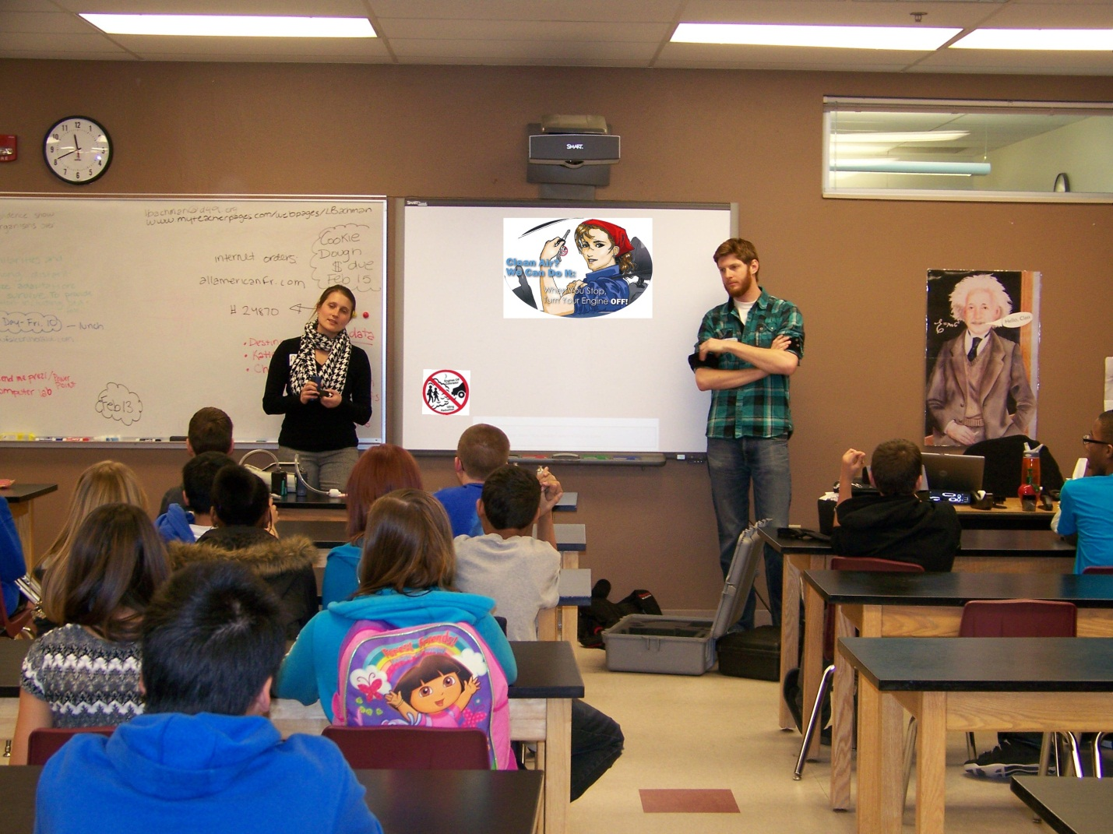
Making it a Student Project
This project could be undertaken by students as a science or community involvement project.
Notes:
Now we can get into how to actually run an idling reduction campaign at a school.
Making it a Student Project:
Getting the students involved is very powerful.
Older kids can run this campaign from start to finish; younger kids can help with certain aspects of it.
This picture was taken from a middle school in CO Springs where the kids helped with the school’s idling reduction campaign and here they are learning about air pollution.
The Colorado Department of Public Health and the Environment funded this campaign through their state-wide Engines Off program.

Slide 14
Making it a Student Project
Students can:
Learn how to run a public service campaign from start to finish
Learn about air quality issues
Conduct the observations
Coordinate the letters and pledges; collect the pledges
Learn interpersonal skills during Driver Contact Event
Work with real life data
Present the data as a science project or to the PTA (public speaking experience)
Notes:
There are roles kids can play throughout all parts of this campaign – running the entire campaign from start to finish, or doing just some of the pieces.
Any age from about 6th grade and up can participate and learn a great deal.
One of the most beneficial areas for the kids is the opportunity to work with real life data collected by them at their own school, and presenting their findings.
Also the interpersonal skills learned at the Driver Contact Event are invaluable.

Slide 15
Making it a Student Project
Notes:
One of the handouts we have is called “Analyzing the Data” and it provides formulas to take the real-life data collected at the school and calculate how much gasoline was wasted and how much pollution was emitted during the observed idling.

Slide 16
Making it a Student Project
Notes:
Here is a snapshot of the formula for calculating the gas used during idling.
Examples are also provided. You’ll see in the sample provided here that one car idling for just 15 minutes, every single day, would waste about $102 in gasoline per year.

Slide 17
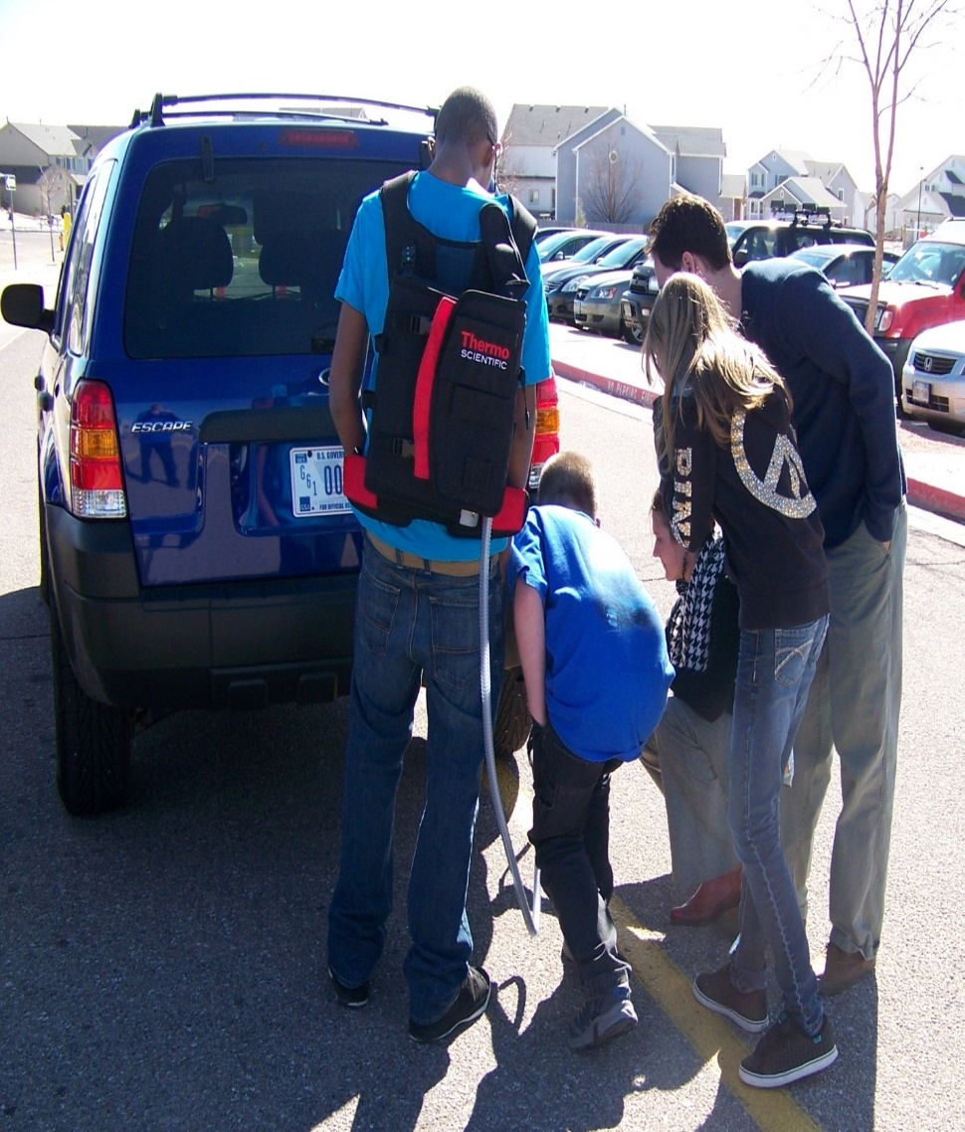
Making it a Student Project
Notes:
This is also from CO Springs. EPA and the Colorado Department of Public Health and the Environment went down and taught the kids about air pollution and showed them how to collect readings of the Volatile Organic Compounds coming out of a tailpipe.

Slide 18
Conduct Observations
Taking observations of driver behavior before and after the campaign can provide powerful data to show parents and students how severe the idling problem at the school is and to demonstrate how effective the campaign was.
Notes:
Conducting Observations:
We strongly recommend taking observations before and after the campaign to provide compelling data for parents.
This is a fun place for students to get involved. They can actually go out and conduct the observations themselves.
Pre-campaign observations are very important because, in our experience, most parents will say that there isn’t a problem at their school. Having the data at the PTA meeting introducing the campaign can be very powerful.
The Toolkit includes instructions on conducting observations as well as a sample observation form that can be copied and used.

Slide 19
How to Conduct Observations
Pre-Campaign Observations should be pre-campaign
Release no information about the idling reduction campaign before the observations
Pre-Campaign Observations should “blind”.
This is essential for obtaining true data
If students conducting the observations, safety comes first!
Provide supervision by adults if necessary
Observations should be observed during afternoon pickup for 4-5 days, if possible.
Schools can decide if morning drop-off is an issue as well.
Notes:
One thing that is crucial with observations is that the pre-campaign observations must be BEFORE any information on the idling reduction campaign is released. The school should not advertise the campaign at all and only essential school personnel (the principal and the school’s champion, be that a teacher or someone from the PTA) should really know what’s going on).
The observations should be “blind”. What we mean by that is that the most people in the school, including those doing the observations, should NOT BE TOLD the true purpose of the observations.
You want to observe the true idling behavior of the parents at the school. If parents know that they are being observed to see if and how much they idle, chances are they won’t idle.
So, for the students or other people doing the observations, you tell them that you are conducting a transportation study for EPA to gather information on the types of cars on the road and on driving behavior in general. That’s as much detail as you give the observers, and then that’s as much detail as they can give drivers.
It should go without saying that if students are conducting the observations, safety should come first. They should be supervised if the school feels it is necessary. They should not be leaving school grounds on their own. Just use common sense.
We recommend afternoon pickup because that is when parents tend to arrive at school early and sit and wait. Morning pickup isn’t always an issue because the line of cars generally moves. But, for some schools it could be, so schools can decide for themselves when to do the observations.
We do recommend 4-5 days. 3 would probably be alright. Just 1-2 wouldn’t be statistically viable, but would still provide students data to work with.

Slide 20
How to Conduct Observations
2-3 sets of observations are recommended
Pre, (Mid) and Post Campaign
Observations should not be combined with the Driver Contact Event
The data will be skewed because drivers will be influenced
Have observers ready to conduct the observations about 20-30 minutes before school is dismissed.
To catch the early arrivers!
Notes:
We recommend 2-3 sets of observations be conducted. Before the campaign begins (in September), in the middle of the campaign (in January, if possible and desired – mid-point observations are optional), and after it ends (in April).
Observations should be done without promoting the campaign. There is a separate Driver Contact Event that we’ll talk about where you hand out flyers and remind parents not to idle. The observation periods should be strictly observation periods so that drivers aren’t encouraged to turn off their engines because someone hands them a flyer. You want to see what their more natural tendency is.
You want to make sure that you have the observers out there about 20-30 minutes before the bell rings because that’s when you’ll get the parents showing up and sitting and waiting. If on the first day you see that there are already quite a few cars out there, you may want to go out earlier the next day.

Slide 21
Observation Sheet
Notes:
The toolkit includes a sample observation form that schools can use. Its very simple. You fill in the observer name, school, zone (which denotes the area of the school they are observing, like the front parking lot, or drop-off loop, or a certain block), the date, time and the current weather.
Then you track each vehicle, their arrival time, whether or not they are idling and for how long.

Slide 22
Idle Free Schools App
Notes:
The Idle Free Schools app is currently available on I-Tunes and is a supplemental, fun way to collect the data – especially for the kids.
It will also analyze the data on the spot and tell them exactly how much gas was wasted and pollutants emitted during their observation session.
These are a couple of the screen shots from the app.
Of course, use of the app would be strictly optional for those who have I-Phones or I-Pads. Everyone else could use the paper forms.

Slide 23
Present Your Data and Introduce the Campaign
Present your data
Great for kids to do!
Explain the new policy
Ask for support
Data Collected | 9/10-13 observations
Total # Vehicles | 100
# Vehicles Idling | 25
Total Idling Mins | 250
Avg. Idle Time/Vehicle | 10
Total Gas Wasted | 2.1 gal
Total $ in Gas Wasted in a Year of Idling | $2,689
Notes:
After the pre-campaign observations, you can present your data and introduce the campaign.
This is great to do at a PTA meeting.
This is the data that we recommend you present and it can be found in the directions for conducting the observations and the calculations can be found in our worksheet, “Analyzing the Data”.
Notes on the calculations, in case asked:
Assumed 13 cars and 12 trucks/SUVs.
13 cars x 10 minutes idling = 130 x .0053 gal/min = .689 gal gas
12 trucks/SUVs x 10 minutes idling = 120 x .0118 gal/min = 1.416 gal gas
Add those together for 2.1 gas gas x $3.50 = $7.37 x 365 = $2,689
130 x 6.19 g CO/min = 804.7
130 x .103 g NOx/min = 13.39
130 x .325 g VOC/min = 42.25
120 x 8.12 g CO/min = 974.4
120 x .125 g NOx/min = 15
120 x .512 g VOC/min = 61.44
For comparison sake, a cigarette has about 67 grams of CO, so this is the equivalent of 26 cigarettes.

Slide 24
Policies, Letters and Pledges
Institute Policies: Include an idling policy in the student handbook and provide to bus drivers.
Inform all Drivers: Regularly tell parents, teachers, staff, delivery truck drivers and bus drivers about the new policy and the campaign.
Pledges: Ask all drivers to sign a pledge not to idle unnecessarily. Hold a contest to see which class returns the most pledges.
Notes:
Then, you get the word out on the campaign.
We have included sample policies for both passenger vehicles as well as buses.
We have included template letters to parents, teachers and staff, truck drivers and bus drivers. All a school has to do is plug in their name and send them out.
We have also included pledges for parents, teachers and staff, truck drivers and bus drivers.
We recommend providing some sort of an incentive for students to return pledges, for example a pizza or ice cream party.

Slide 25
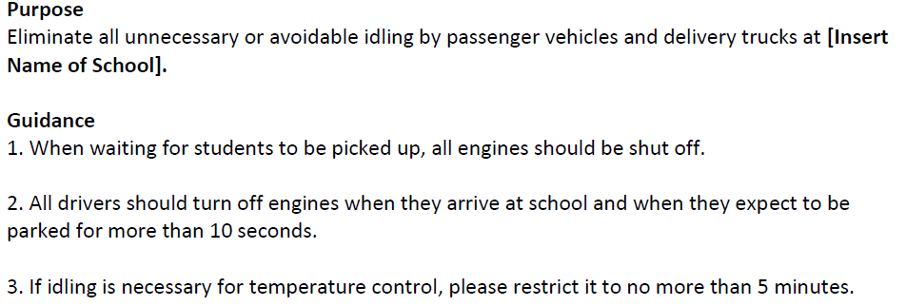
Sample Idling Policy for Passengers Vehicles and Delivery Trucks
Notes:
This is the actual example policy for passenger vehicles and delivery trucks.
The crux of it is that parents should shut off their cars when waiting for students; and delivery truck drivers should shut off their engines if they will be parked for more than 10 seconds.
I do want to note that the aim is eliminating all unnecessary idling. If it is 5 degrees outside, idling is an unfortunate necessity; although you can limit it to 5 minutes at a time.

Slide 26
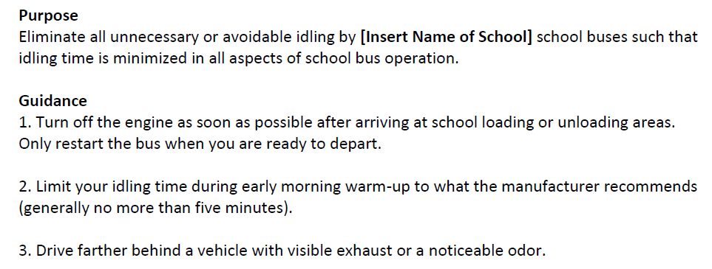
Sample Idling Policy for Bus Drivers
Notes:
This is the sample idling policy for bus drivers.

Slide 27
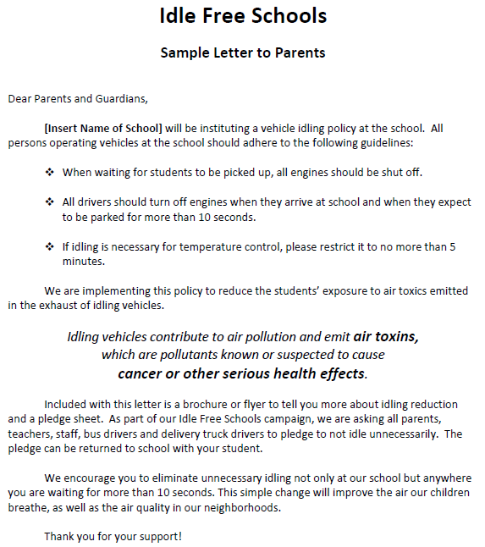
Notes:
Here is the sample letter for parents that schools can personalize and send home.

Slide 28
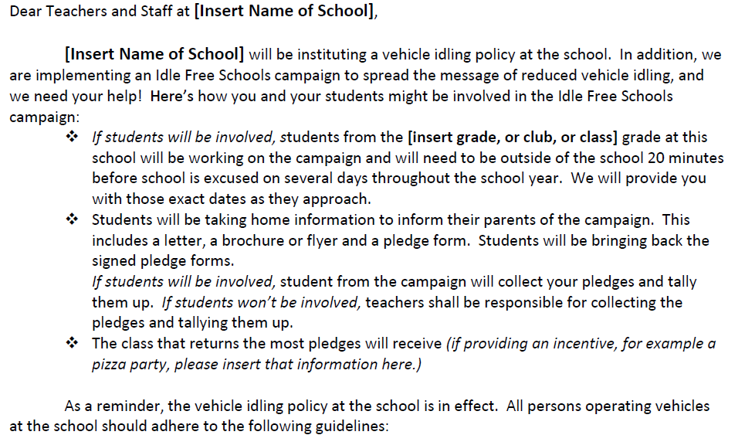
Notes:
There is also a letter for teachers that focuses on student involvement in the project.
And there’s one for bus drivers that focuses on fuel savings as well as children’s health.

Slide 29
Inform Drivers – Letter to Delivery Truck Drivers
Notes:
This is a snippet from the letter for delivery truck drivers. It concentrates on fuel savings from not idling.

Slide 30
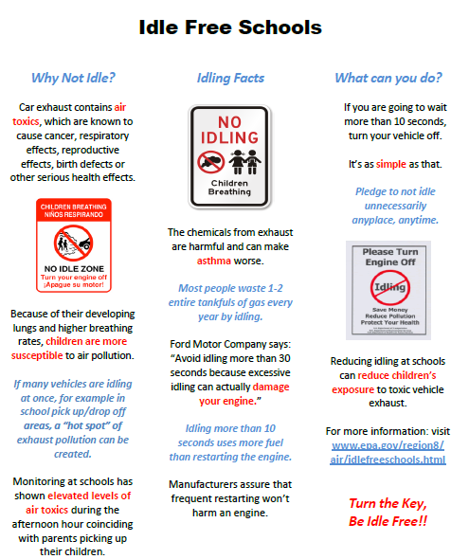
Notes:
This is the Idle Free Schools flyer that would be included with the letters and handed out during the Driver Contact Event.

Slide 31
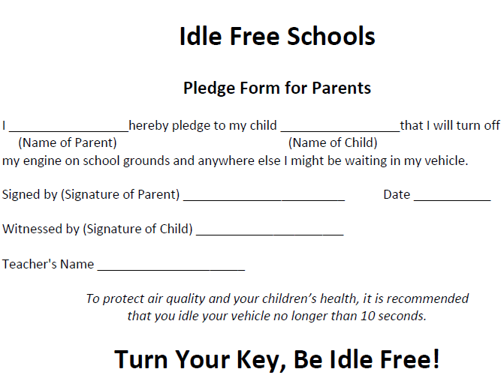
Notes:
This is the pledge form parents would be asked to sign.
There are separate pledge forms for the teachers, truck drivers and bus drivers.

Slide 32
Notes:
The pledge for bus drivers is different and is from EPA’s Clean School Bus Program and is part of a really nice brochure they have that is just targeted toward reducing idling from school buses.

Slide 33
Idling Signs
Install external idling signs:
Where parents will easily see them when picking up students
Where buses congregate
Where truck drivers stop to make deliveries
Notes:
Right after you get the word out on the campaign, you want to get up your signs (in around November).
You want to make sure you cover all areas where parents pick up students, where school buses congregate and where truck drivers might idle during deliveries.
Unfortunately, EPA does not have any funding available, which means schools have to purchase their own signs.
The signs are only about $35 a piece and the number required by a school would depend on how large the school is and how many parking “areas” the school has.

Slide 34
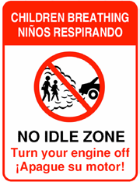
Idling Signs
Notes:
We provide these two JPEGs that can be used to order signs, or you can use a different one you find, or even make your own.

Slide 35
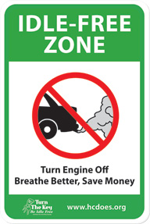
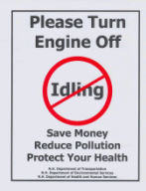
Idling Signs
Notes:
There is a plethora of no idle sign images available.

Slide 36
Driver Contact Event
Talk to Drivers:
Have at least one annual “driver contact event”, where drivers are approached, offered a flyer, and either thanked for not idling or informed about the school’s idling reduction campaign.
Notes:
Then in around March, you do the Driver Contact Event, where all parents in vehicles are approached and either thanked for not idling or informed about the school’s idling policy.
This is a great event for the kids to do as well. The kids really get into this one and its great experience in using tact, kindness and positive reinforcement to get the results you want.

Slide 37
Driver Contact Event
Should occur after the campaign was publicized, the idling signs are posted, letters have been sent home and pledges collected.
Should occur separately from observations.
Great for the kids to do!
Approach everyone
Thank drivers who are not idling
Remind drives who are idling about the policy
Offer everyone a flyer, and if possible, an incentive.
Notes:
The driver contact event should happen separately from any observations; again, so you don’t influence behavior.
You want to be sure to approach all drivers. Thanking the drivers who aren’t idling provides positive reinforcement for your message.
Offer the Idle Free Schools flyer to all drivers.
Its also great to have an incentive, like a keychain, to give out to parents also.

Slide 38
Providing Incentives
Provide incentives to drivers during the “driver contact event”, to classes that return the most pledges, to parents that return pledges, etc.
Example incentives could be key chains with the school logo on one side and the “turn the key, be idle free” logo on the other, gift cards or coupons from local vendors, a pizza party or ice cream party for the class with the most pledges, etc.
Notes:
We recommend providing incentives for the Driver Contact event, for example key chains with the school’s logo on one side and the Turn Your Key, Be Idle Free Logo on the other side.
We like this particular incentive because parents are more likely to use a keychain with the school logo on it as well.
We also recommend providing incentives for the classes that return the most pledges, for parents that return pledges, whatever the school thinks is appropriate.
Unfortunately, EPA does not have funding available, so these would be additional costs the school would have to cover.

Slide 39
Turn Your Key, Be Idle Free Logo
Notes:
Here is the Turn Your Key, Be Idle Free logo.
This logo was created by the Idle Free Utah campaign and they kindly let us use it for our Toolkit and have made it available for others to use in their campaigns.

Slide 40
Publish Articles
Notes:
We recommend publishing articles in the school newsletter at the beginning of the campaign and then at least once a year.

Slide 41
Recommended Schedule
Early to Mid September: Pre-Campaign Observations
Late September: Announce campaign to school, PTA
October: Publish policies, send home letters, conduct pledge drive, publish articles in school newsletter
November: Hang up signs
January: Mid-Campaign Observations (Optional)
March: Driver Contact Event
April: Post Campaign Observations
Annually: Reminders; 1 Driver Contact Event
Notes:
This is what the recommended schedule looks like. Of course each school needs to determine what they can and cannot do.
As you can see, the schedule we recommend goes through the whole school year with minimal continuing activities in subsequent years.

Slide 42
Keep Up the Good Work!
Continue the campaign into subsequent years, for example:
Continue to teach students about air quality issues and air pollution.
Continue to publish reminders about the no idling policy in the school newsletter.
Conduct one driver contact event per school year.
Notes:
Its essential to keep the program up.
New parents come to a school every year and returning parents need to be reminded.
Publishing annual reminders about the policy is essential.
And having one driver contact event per school year is not very time consuming or difficult, but its very important and is a great activity for the kids to do.

Slide 43
Tools and Assistance
More information can be found at: www.epa.gov/region8/air/idlefreeschools
For more information or assistance, or for an electronic copy of the entire Toolkit, please contact:
Rebecca Russo, US EPA, 303-312-6757, russo.rebecca@epa.gov
Marisa McPhilliamy, US EPA, 303-312-6965, mcphilliamy.marisa@epa.gov
Notes:
Here is the Idle Free Schools website address and our contact information.
Some of the materials can be found on the website, but to get a full electronic copy of the toolkit, you need to contact me or my colleague Marisa. We are also available for assistance with the campaigns.

